Slide 1


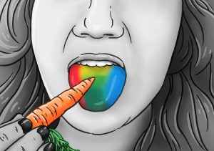
Side Effects may include Seeing
Music and Tasting
Colors
Exploring the antidepressant effects of Salvia
Jazmine Yaeger

Slide 2
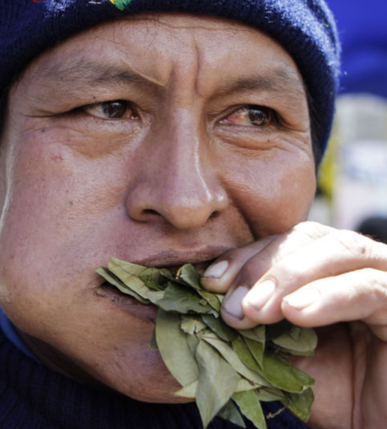
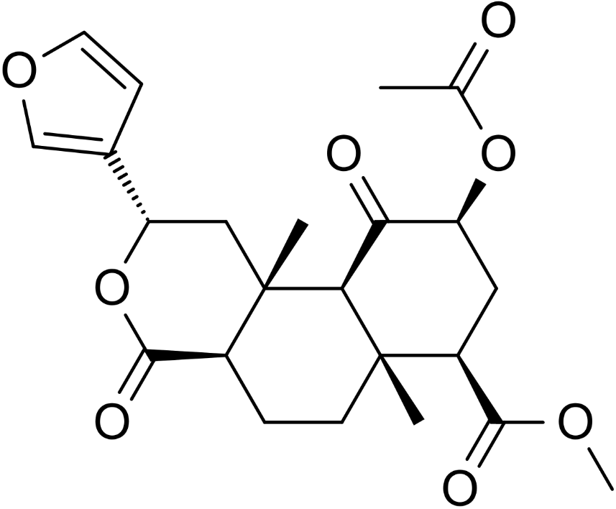
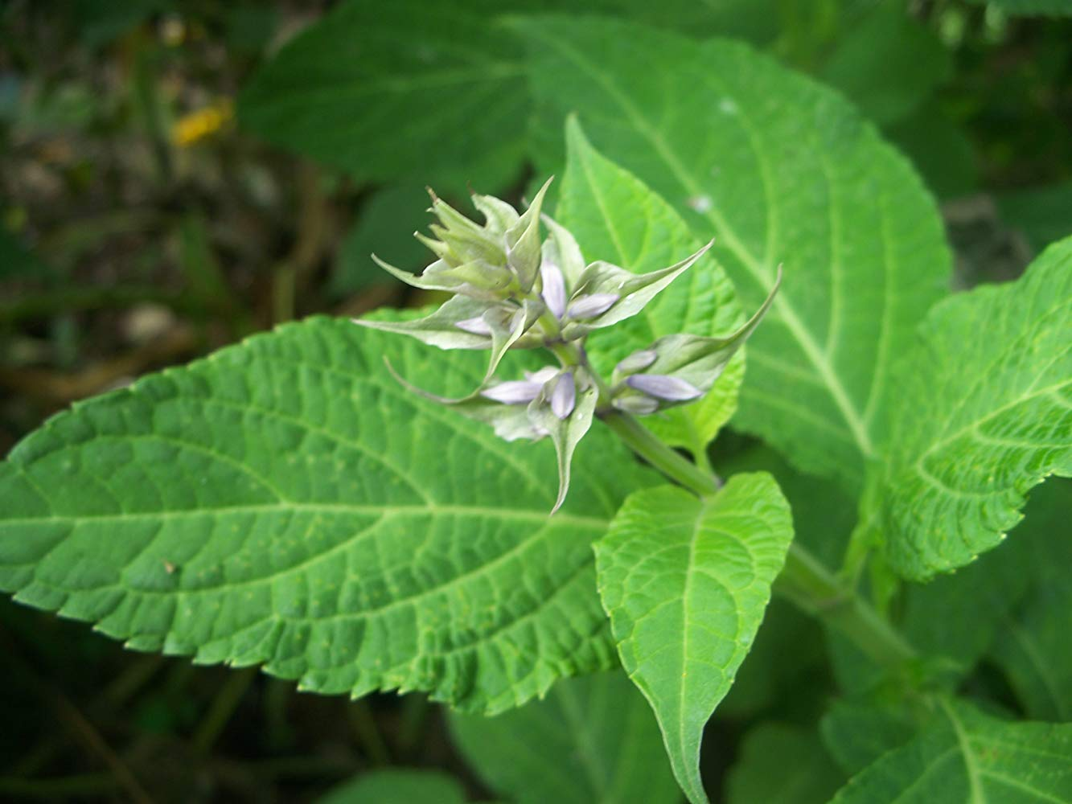
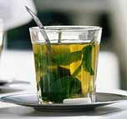

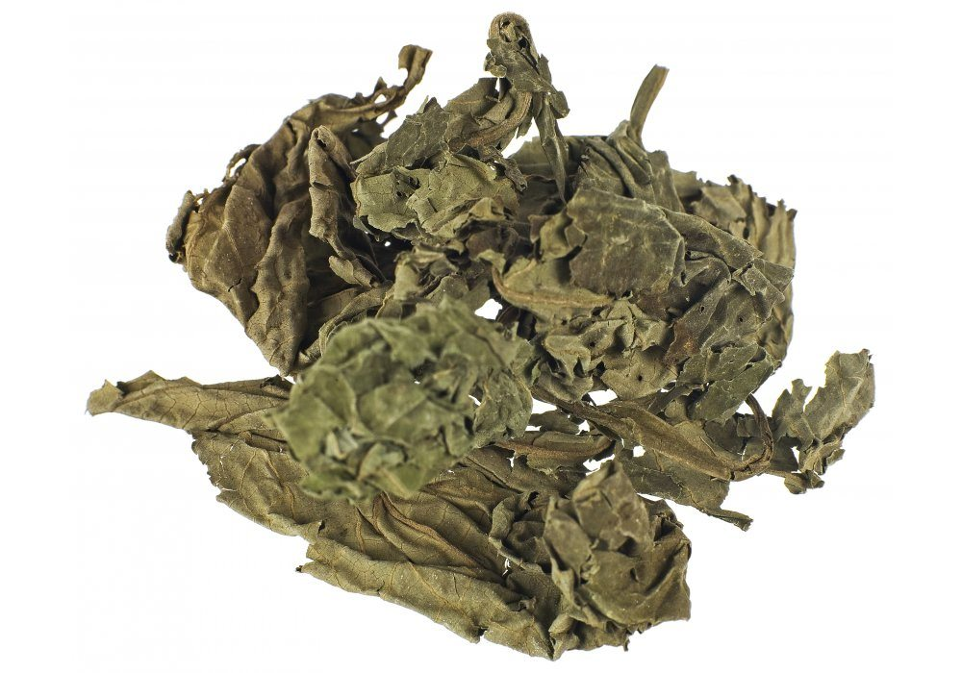
Salvinorin A

Slide 3

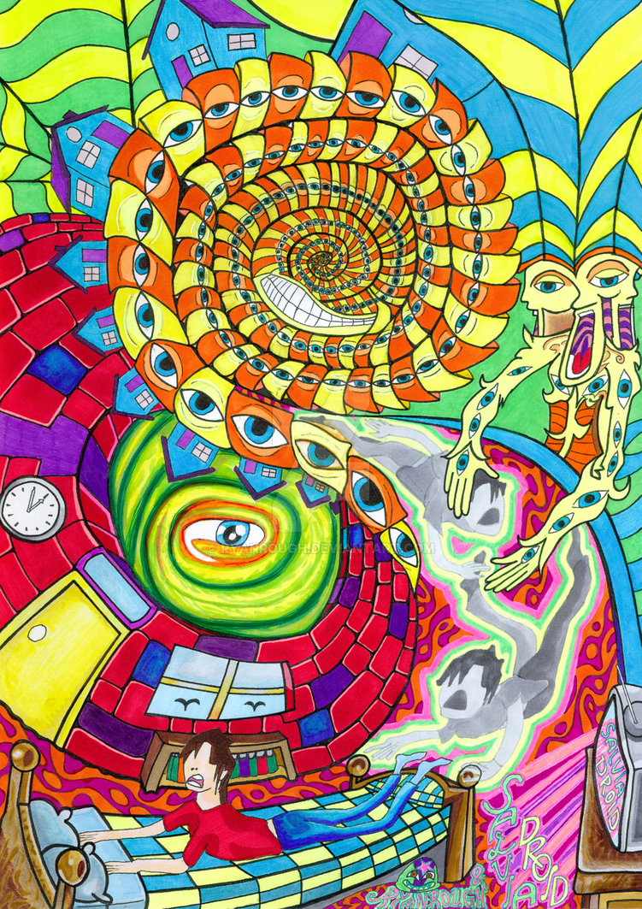
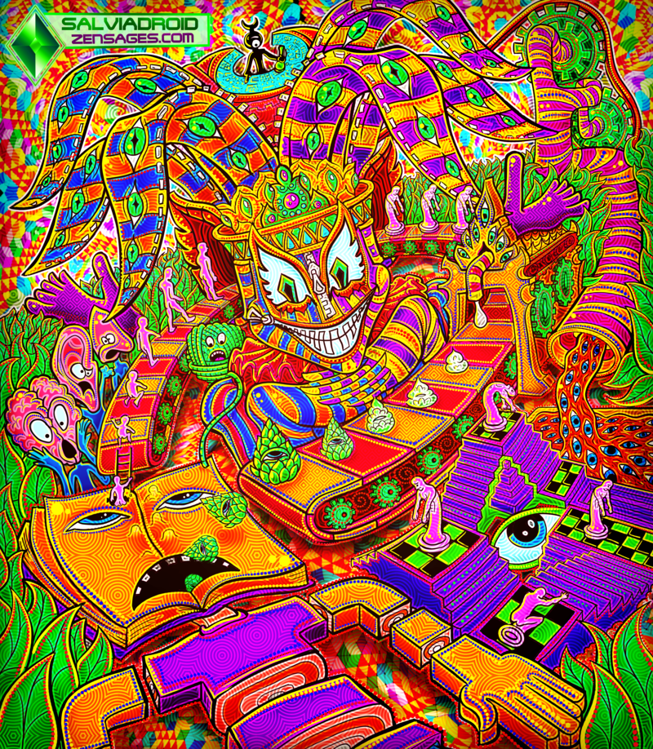

What does 30 minutes of Salvia high feel like?
Loss of physical coordination
Uncontrollable laughter
Visual alterations or visions
Experiencing multiple realities
A contemplative sense of peace
Sense of profound understanding
Dream-like veneer over the world
Sense of total confusion or madness
Seeing or becoming part of a tunnel
Loss of sense of awareness as an individual
Experiencing a “non-Euclidean” geometry
Sense of flying, floating, twisting, or turning
Feeling of being immersed in an energy field
Feeling of being connected to a larger “whole”
Feeling of being underground or underwater
Appearing to travel to other places and/or times
Becoming inanimate objects (a wall, stairs, a couch, etc.)
Viewing patterns or shapes that are tube-like, snake-like, or worm-like
http://duskmoor.blogspot.com/2011/06/salvia-divinorum-shamans-secret.html

Slide 4

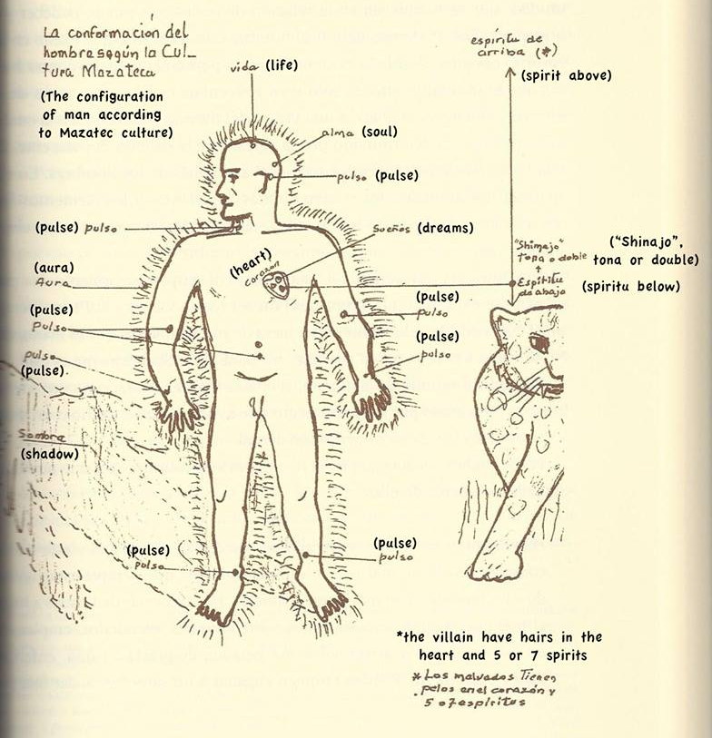
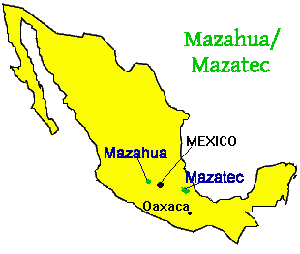
History of Salvia Use
Disharmony
Fear
Soul Loss

Slide 5
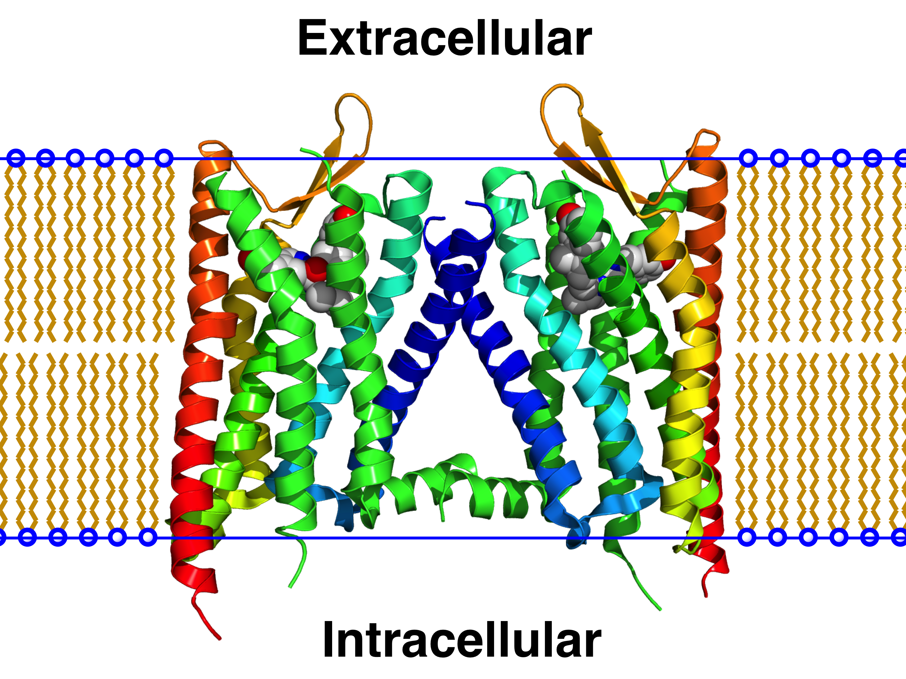
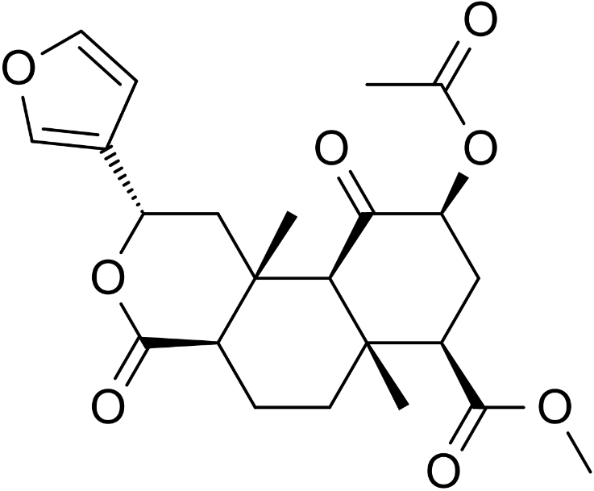
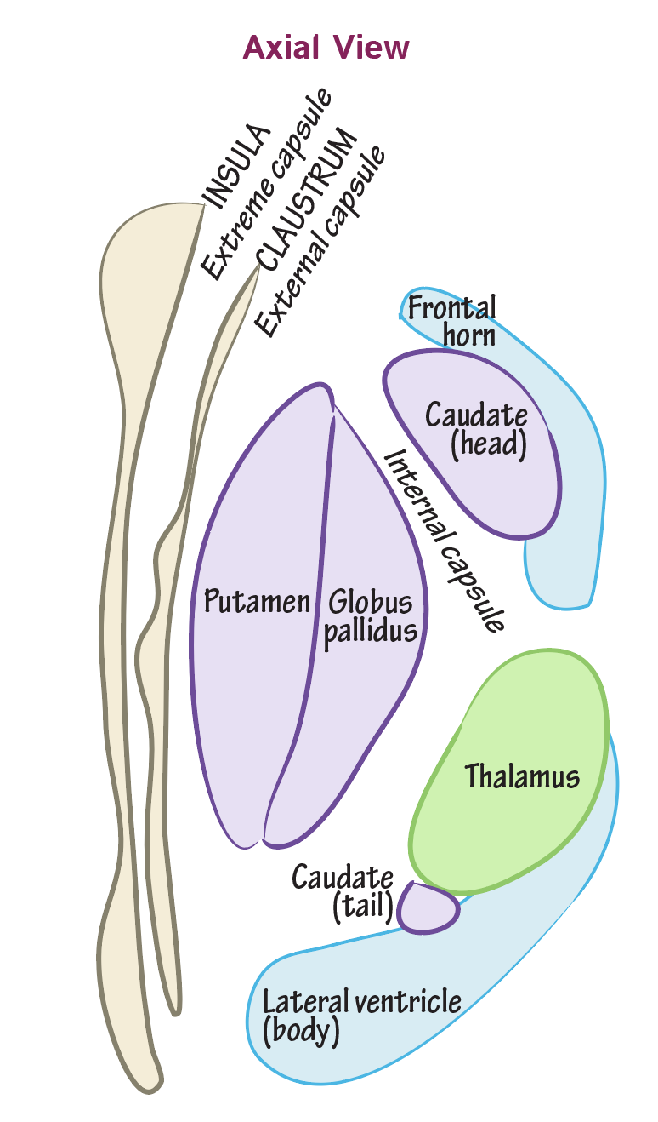

Pharmacology of Salvinorin A
Almost everywhere in CNS
  Most dense in claustrum
Inhibitory (G_{i})
Dynorphin – endogenous ligand
Activation behavioral effects:
  Analgesia
  Loss of consciousness
  Blockade of drug seeking
  ↓ Depression
Chavkin, C., Sud, S., Jin, W., Stewart, J., Zjawiony, J. K., Siebert, D. J., ... & Roth, B. L. (2004). Salvinorin A, an active component of the hallucinogenic sage Salvia divinorum is a highly efficacious κ-opioid receptor agonist: structural and functional considerations. Journal of Pharmacology and Experimental Therapeutics, 308(3), 1197-1203.

Slide 6
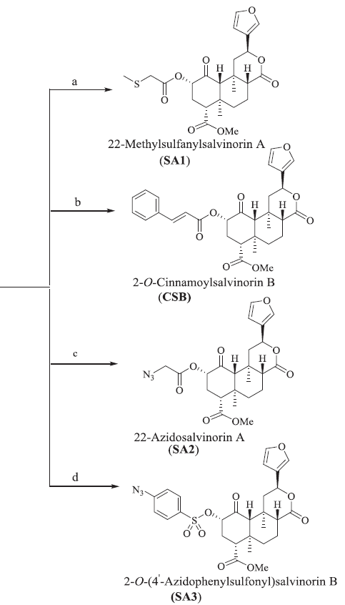
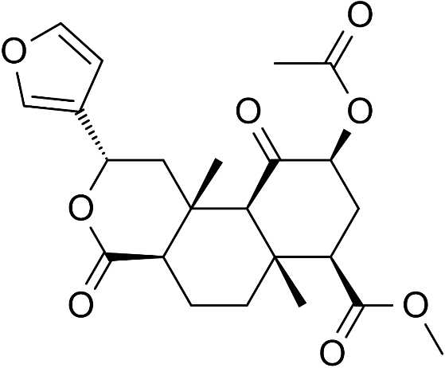
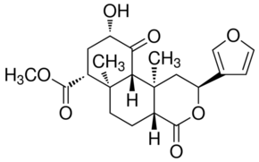
Pharmacology of Salvinorin A
15-60 min?
Full return to normal behaviors after 1 week
~ 30 minutes
~ 2-3 hours
Fajemiroye, J. O., et al. (2017). "22-azidosalvinorin A exhibits antidepressant-like effect in mice." European Journal of Pharmacology 800: 96-106.

Slide 7
Activation of Κappa is Pro-Depressive
Maybe…

Slide 8

Depression in Humans
Disharmony
Fear
Soul Loss
Trouble concentrating, remembering details, and making decisions
Fatigue
Feelings of guilt, worthlessness, and helplessness
Pessimism and hopelessness
Insomnia, early-morning wakefulness, or sleeping too much
Irritability
Restlessness
Loss of interest in things once pleasurable, including sex
Overeating, or appetite loss
Aches, pains, headaches, or cramps that won't go away
Digestive problems that don't get better, even with treatment
Persistent sadness
Unexplained anxiety
“Empty" feelings
Suicidal thoughts or attempts
https://www.webmd.com/depression/guide/detecting-depression#1

Slide 9
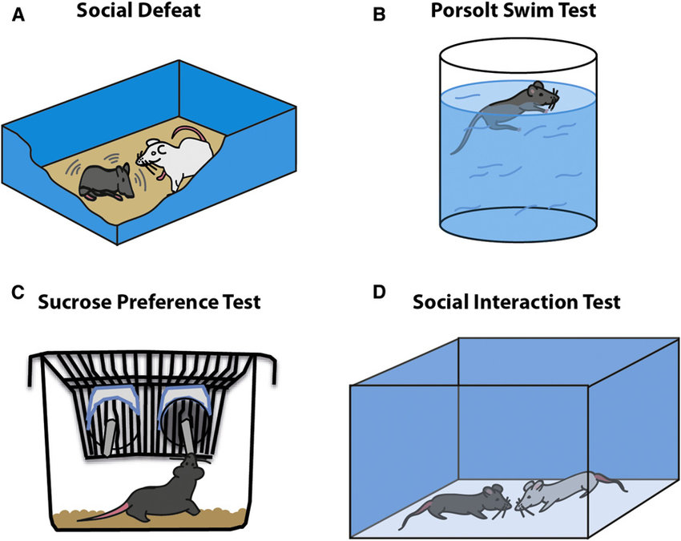
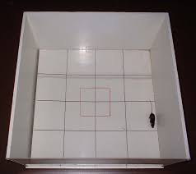
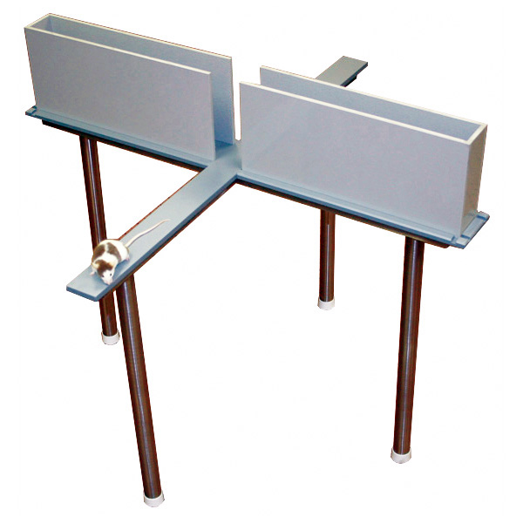
Depression in Rodents
3 Day Paradigm (7 min or 7 attacks)
10 Day Paradigm – Social interaction every other day (30 min)
Sexual Pursuit Test
Franklin, T., et al. (2012). Neural Mechanisms of Stress Resilience and Vulnerability.

Slide 10
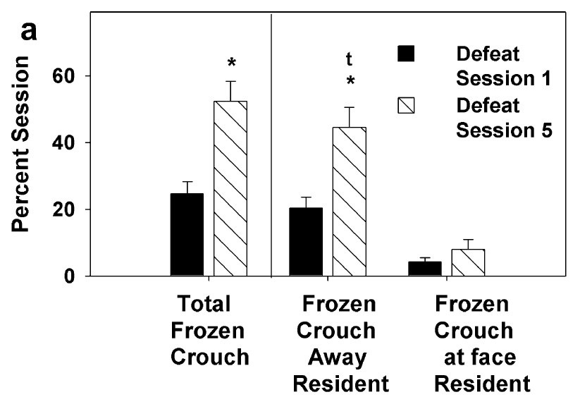
Defeat in Rodents
Nocjar, C., et al. (2012). "The social defeat animal model of depression shows diminished levels of orexin in mesocortical regions of the dopamine system, and of dynorphin and orexin in the hypothalamus." Neuroscience 218: 138-153.

Slide 11
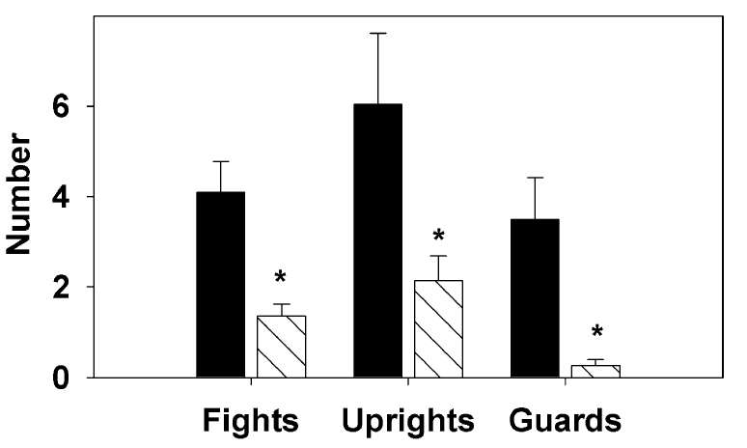
Defeat in Rodents
Nocjar, C., et al. (2012). "The social defeat animal model of depression shows diminished levels of orexin in mesocortical regions of the dopamine system, and of dynorphin and orexin in the hypothalamus." Neuroscience 218: 138-153.

Slide 12
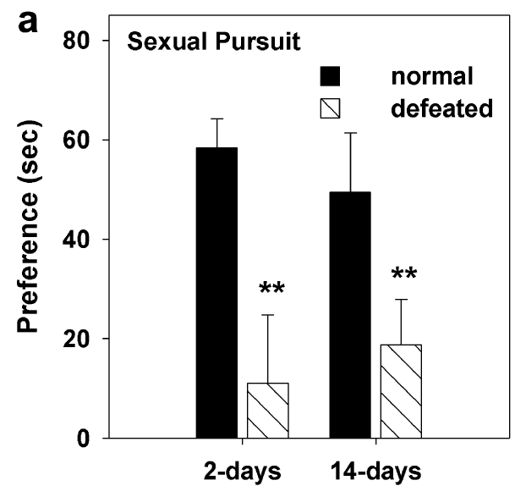
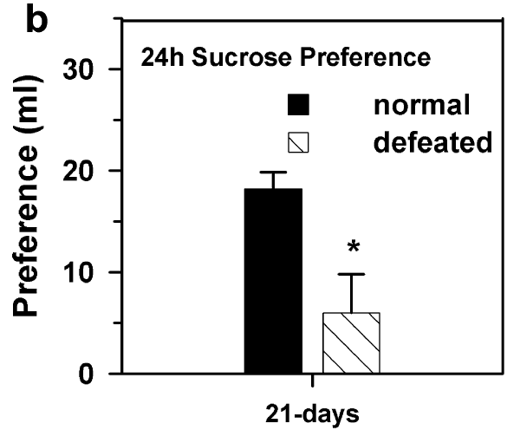
Anhedonia after Defeat in Rodents
Nocjar, C., et al. (2012). "The social defeat animal model of depression shows diminished levels of orexin in mesocortical regions of the dopamine system, and of dynorphin and orexin in the hypothalamus." Neuroscience 218: 138-153.

Slide 13
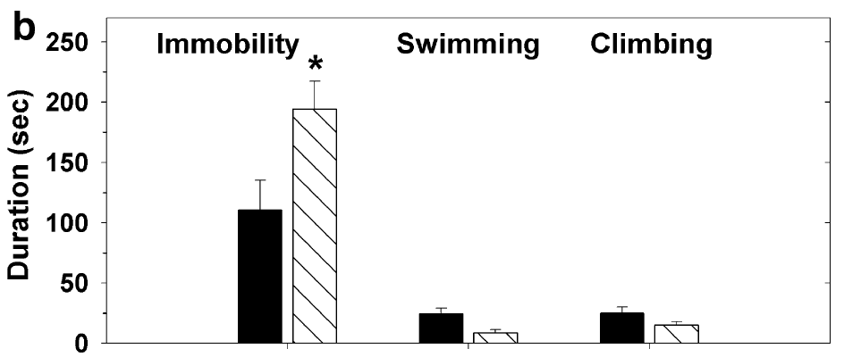
Despair after Defeat in Rodents
Nocjar, C., et al. (2012). "The social defeat animal model of depression shows diminished levels of orexin in mesocortical regions of the dopamine system, and of dynorphin and orexin in the hypothalamus." Neuroscience 218: 138-153.

Slide 14


Depression in Rodents
Defeat:
Behavioral Inhibition
Anhedonia
Despair
And Kappa Activation can cause ALL of this…
(Maybe…)

Slide 15
Kappa’s Pro-Depressive Effects
(26% DMSO)
(KOR Agonist)
(KOR Agonist)
Williams, A. V., et al. (2018). "Acute inhibition of kappa opioid receptors before stress blocks depression-like behaviors in California mice." Progress in Neuro-Psychopharmacology and Biological Psychiatry 86: 166-174.

Slide 16

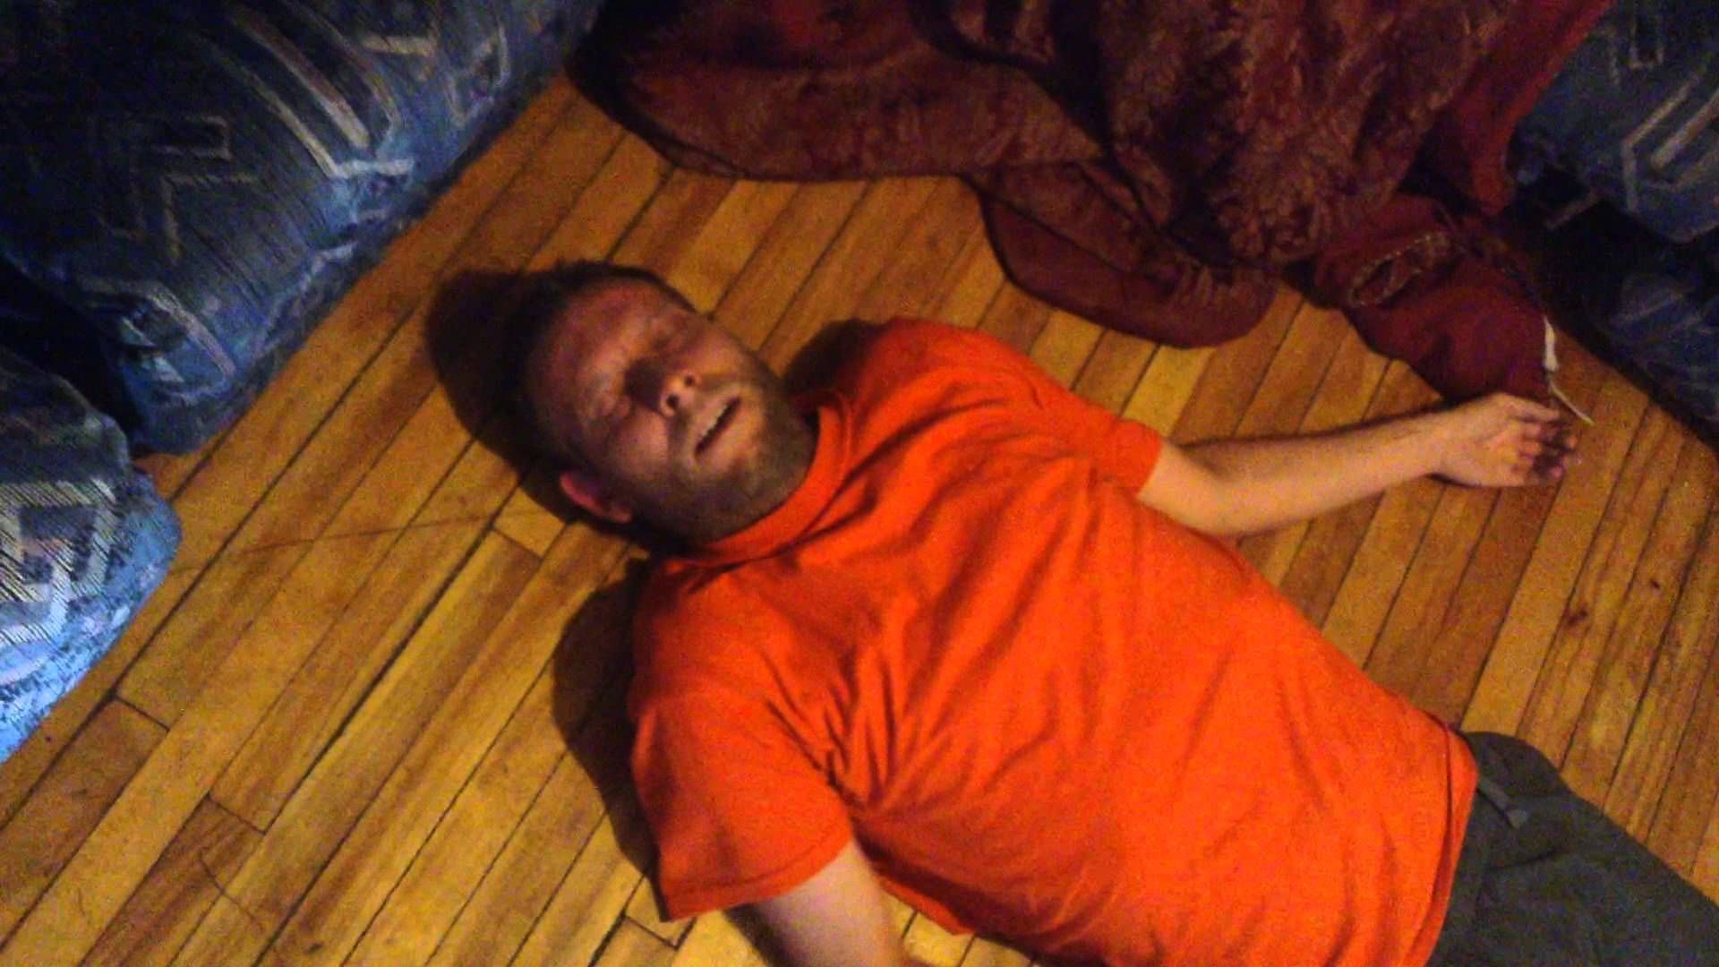
Kappa’s Pro-Depressive Effects
Kappa Activation:
↓ Locomotion in OF
↑ Immobility in FST
Pro-depressive
or
Sedative?

Slide 17

Kappa’s Pro-Depressive Effects
Williams, A. V., et al. (2018). "Acute inhibition of kappa opioid receptors before stress blocks depression-like behaviors in California mice." Progress in Neuro-Psychopharmacology and Biological Psychiatry 86: 166-174.

Slide 18

Kappa’s Pro-Depressive Effects
U50,488 = Kappa Agonist
Williams, A. V., et al. (2018). "Acute inhibition of kappa opioid receptors before stress blocks depression-like behaviors in California mice." Progress in Neuro-Psychopharmacology and Biological Psychiatry 86: 166-174.

Slide 19
Kappa’s Pro-Depressive Effects
U50,488 = Kappa Agonist
Williams, A. V., et al. (2018). "Acute inhibition of kappa opioid receptors before stress blocks depression-like behaviors in California mice." Progress in Neuro-Psychopharmacology and Biological Psychiatry 86: 166-174.

Slide 20

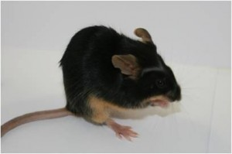
Kappa’s Pro-Depressive Effects
Williams, A. V., et al. (2018). "Acute inhibition of kappa opioid receptors before stress blocks depression-like behaviors in California mice." Progress in Neuro-Psychopharmacology and Biological Psychiatry 86: 166-174.

Slide 21

Kappa’s Pro-Depressive Effects
Williams, A. V., et al. (2018). "Acute inhibition of kappa opioid receptors before stress blocks depression-like behaviors in California mice." Progress in Neuro-Psychopharmacology and Biological Psychiatry 86: 166-174.

Slide 22

Kappa’s Pro-Depressive Effects
Williams, A. V., et al. (2018). "Acute inhibition of kappa opioid receptors before stress blocks depression-like behaviors in California mice." Progress in Neuro-Psychopharmacology and Biological Psychiatry 86: 166-174.

Slide 23
Kappa’s Pro-Depressive Effects
Williams, A. V., et al. (2018). "Acute inhibition of kappa opioid receptors before stress blocks depression-like behaviors in California mice." Progress in Neuro-Psychopharmacology and Biological Psychiatry 86: 166-174.

Slide 24
Kappa’s Pro-Depressive Effects
Williams, A. V., et al. (2018). "Acute inhibition of kappa opioid receptors before stress blocks depression-like behaviors in California mice." Progress in Neuro-Psychopharmacology and Biological Psychiatry 86: 166-174.

Slide 25
Kappa’s Pro-Depressive Effects
Williams, A. V., et al. (2018). "Acute inhibition of kappa opioid receptors before stress blocks depression-like behaviors in California mice." Progress in Neuro-Psychopharmacology and Biological Psychiatry 86: 166-174.

Slide 26
Kappa’s Pro-Depressive Effects
Williams, A. V., et al. (2018). "Acute inhibition of kappa opioid receptors before stress blocks depression-like behaviors in California mice." Progress in Neuro-Psychopharmacology and Biological Psychiatry 86: 166-174.

Slide 27
Kappa’s Pro-Depressive Effects
Williams, A. V., et al. (2018). "Acute inhibition of kappa opioid receptors before stress blocks depression-like behaviors in California mice." Progress in Neuro-Psychopharmacology and Biological Psychiatry 86: 166-174.

Slide 28
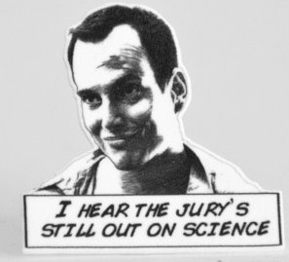
Kappa’s Pro-Depressive Effects
Kappa Inhibition Rehabilitates Depressive Behavior
↓ Autogrooming
↓ Anhedonia
↓ Social Avoidance
Therefore…Kappa is PRO-Depressive…Right?
It may not be that simple…

Slide 29


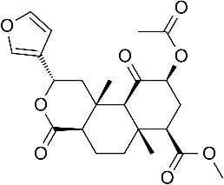
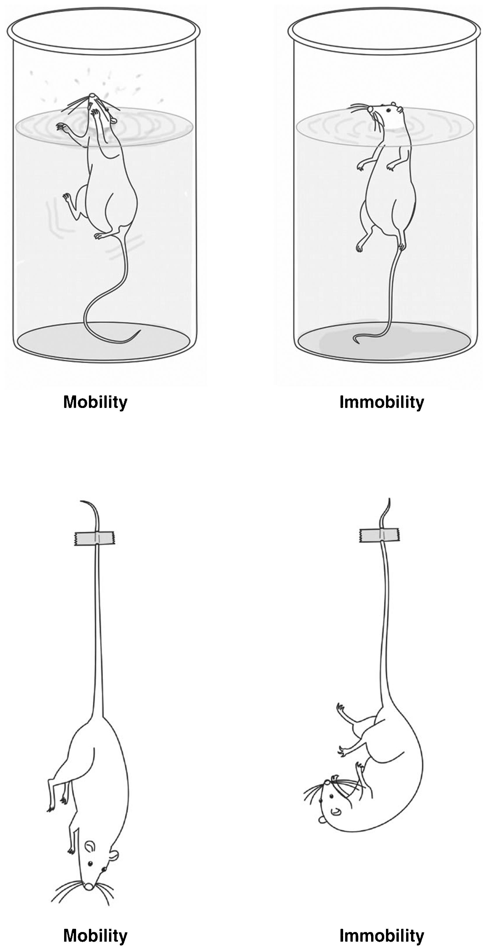
Are Salvinorin A Derivatives Anti-Depressive?
Remember these?
Salvinorin A
(Imipramine)
Fajemiroye, J. O., et al. (2017). "22-azidosalvinorin A exhibits antidepressant-like effect in mice." European Journal of Pharmacology 800: 96-106.

Slide 30
Is 22-Azidosalvinorin A Anti-Depressive?
(Imipramine)
Fajemiroye, J. O., et al. (2017). "22-azidosalvinorin A exhibits antidepressant-like effect in mice." European Journal of Pharmacology 800: 96-106.

Slide 31
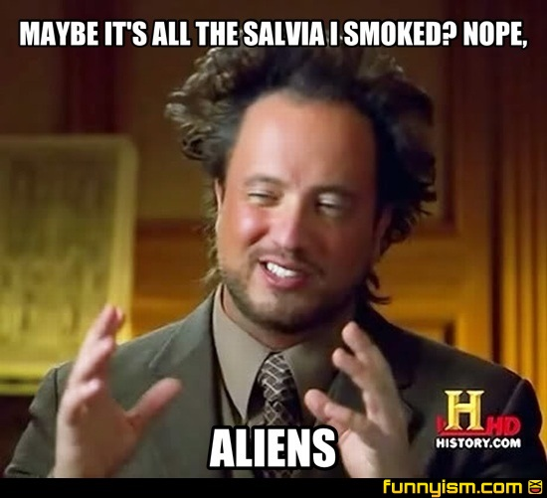
22-Azidosalvinorin A has Anti-depressive Qualities
↓ Immobility Time in TST & FST
↑ Swimming in FST
But what are the mechanisms…and is Kappa even involved?

Slide 32
Anti-Depressive Mechanisms of 22-Azidosalvinorin A
AMPT = catecholamine depleter
PCPA = serotonin depleter
PRAZ = α₁ adrenoreceptor antagonist
WAY = 5-HT_{1A} receptor antagonist
Fajemiroye, J. O., et al. (2017). "22-azidosalvinorin A exhibits antidepressant-like effect in mice." European Journal of Pharmacology 800: 96-106.

Slide 33
Anti-Depressive Mechanisms of 22-Azidosalvinorin A
MAO_{A}
MAO_{B}
Fajemiroye, J. O., et al. (2017). "22-azidosalvinorin A exhibits antidepressant-like effect in mice." European Journal of Pharmacology 800: 96-106.

Slide 34

Anti-Depressive Mechanisms of 22-Azidosalvinorin A
α₁ receptor affinity:
α_{1A} – K_{i} = 27,001 nM
α_{1B} – K_{i} = 31,110 nM
α_{1D} – K_{i} = 27,577 nM
For Reference:
ΚOR – K_{i} = 8.1 nM
MOR – K_{i} = > 10,000 nM
DOR – K_{i} = 4,230 nM
Salvinorin A:
ΚOR – K_{i} = 1.2 nM
Fajemiroye, J. O., et al. (2017). "22-azidosalvinorin A exhibits antidepressant-like effect in mice." European Journal of Pharmacology 800: 96-106.

Slide 35

Complete and Utter Confusion!
22-Azidosalvinorin A:
Strongly binds & activates the Kappa Receptor
↓Depressive Behaviors
AZ-MTAB:
Strongly binds & inhibits the Kappa Receptor
↓Depressive Behaviors

Slide 36
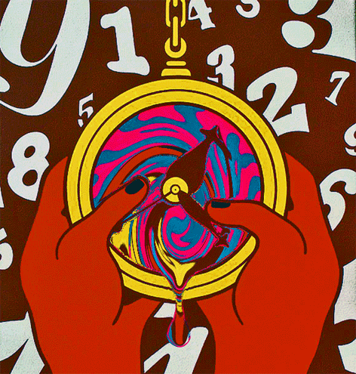
Complete and Utter Confusion!
How important is timing?

Slide 37
Considering Time
Blockade of Kappa to ↓ Depression:
Activation of Kappa to ↓ Depression:
No Defeat…

Slide 38
Kappa Inhibition after Defeat
U50,488 = Kappa Agonist
AZ-MTAB = Kappa Antagonist
Williams, A. V., et al. (2018). "Acute inhibition of kappa opioid receptors before stress blocks depression-like behaviors in California mice." Progress in Neuro-Psychopharmacology and Biological Psychiatry 86: 166-174.

Slide 39
Kappa Inhibition after Defeat
U50,488 = Kappa Agonist
AZ-MTAB = Kappa Antagonist
Williams, A. V., et al. (2018). "Acute inhibition of kappa opioid receptors before stress blocks depression-like behaviors in California mice." Progress in Neuro-Psychopharmacology and Biological Psychiatry 86: 166-174.

Slide 40
Kappa Inhibition after Defeat
Williams, A. V., et al. (2018). "Acute inhibition of kappa opioid receptors before stress blocks depression-like behaviors in California mice." Progress in Neuro-Psychopharmacology and Biological Psychiatry 86: 166-174.

Slide 41
Kappa Inhibition after Defeat
Williams, A. V., et al. (2018). "Acute inhibition of kappa opioid receptors before stress blocks depression-like behaviors in California mice." Progress in Neuro-Psychopharmacology and Biological Psychiatry 86: 166-174.

Slide 42
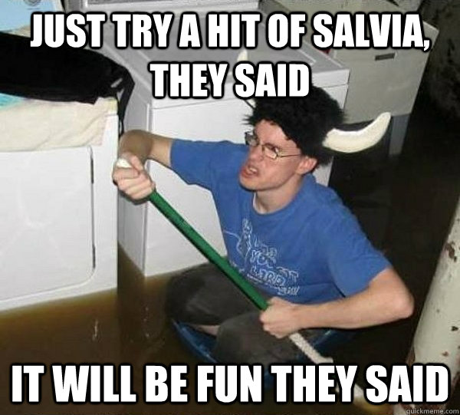
Timing is Important
Blockade of KOR to ↓ Depression:
Must be prior/during stress
What about activation of KOR through drugs like Salvia?

Slide 43

Possible Explanations
Hypothalamic Peptide Theory
Receptor Theory
Claustrum Theory

Slide 44
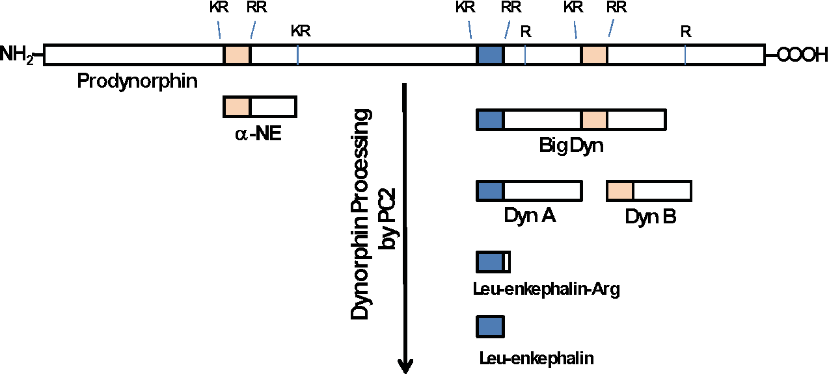
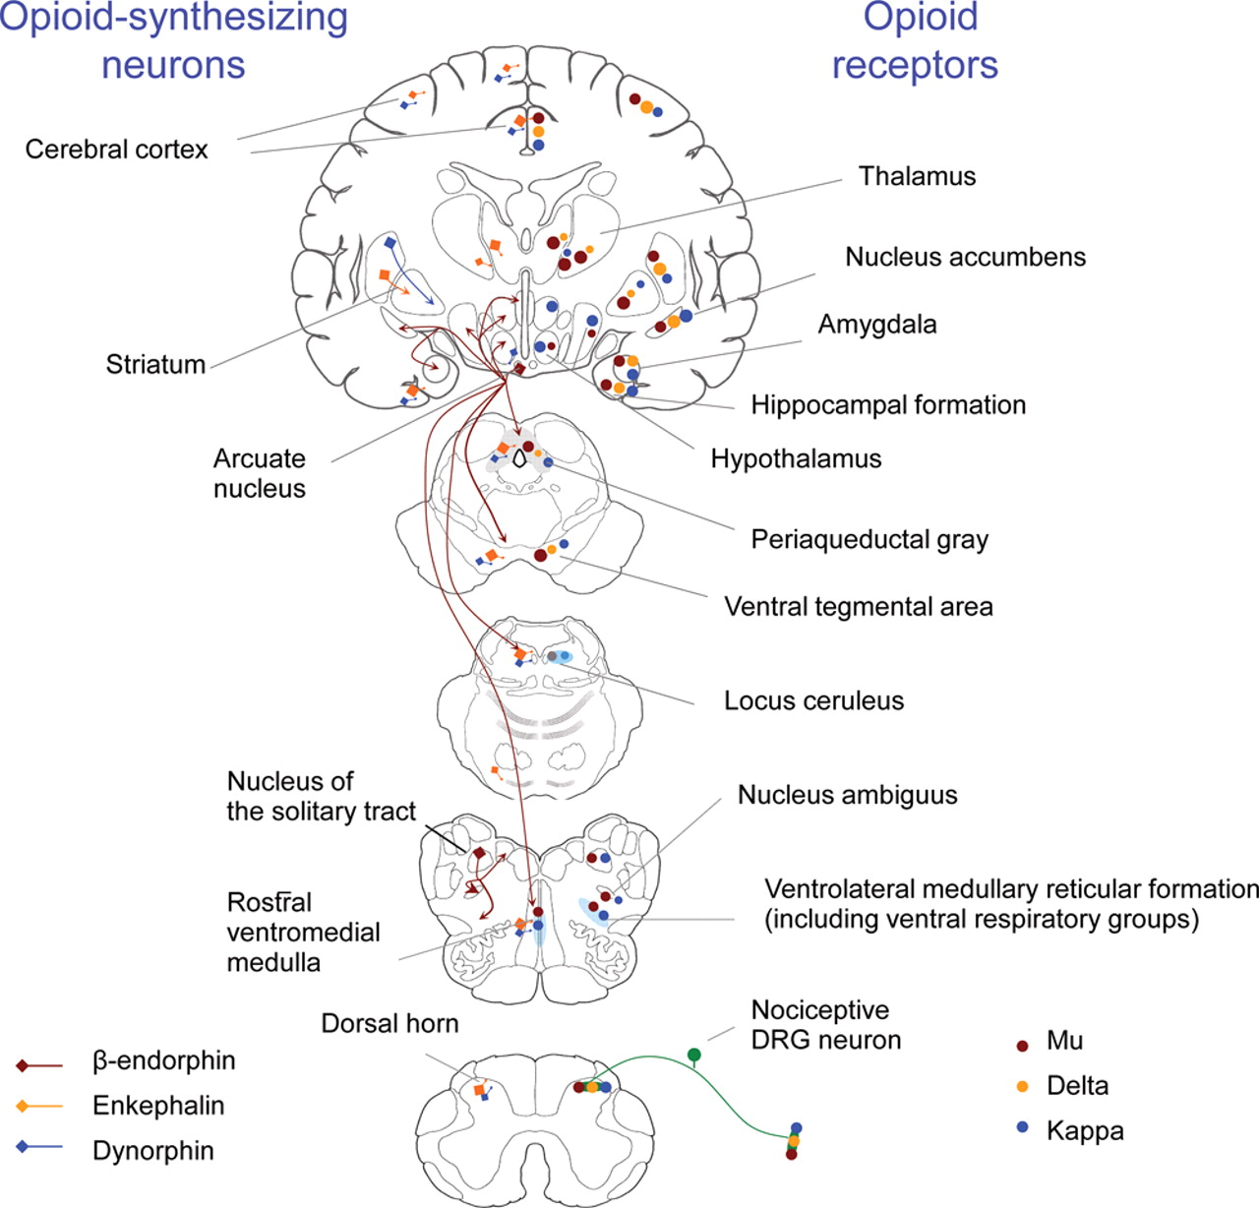
Hypothalamic Peptide Theory
(α-neo-endorphin)
(proprotein convertase 2)
Motivated behaviors (addiction)
Stress response
Appetite
Biological rhythms
Hugonin, L. (2007). Spectroscopic studies of dynorphin neuropeptides and the amyloid β peptide The consequences of biomembrane interactions.

Slide 45
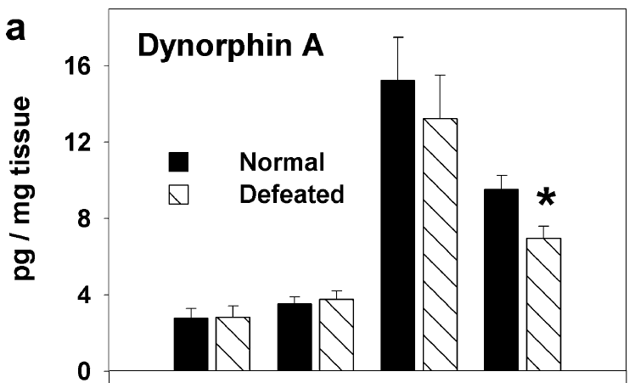
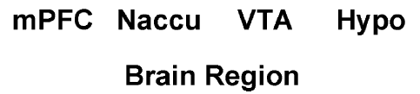
Hypothalamic Peptide Theory
Nocjar, C., et al. (2012). "The social defeat animal model of depression shows diminished levels of orexin in mesocortical regions of the dopamine system, and of dynorphin and orexin in the hypothalamus." Neuroscience 218: 138-153.

Slide 46
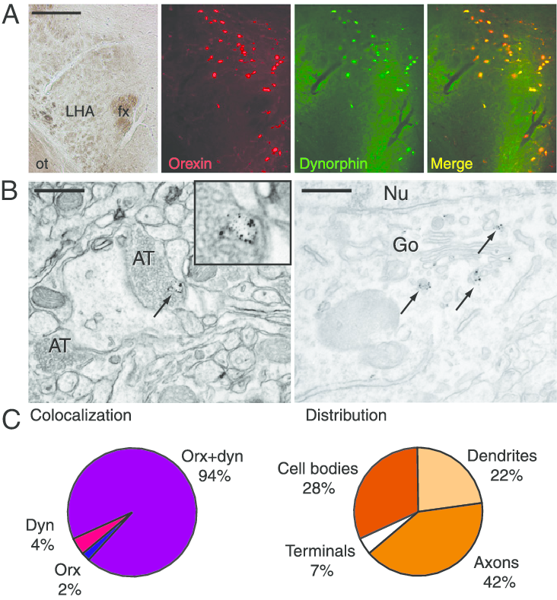
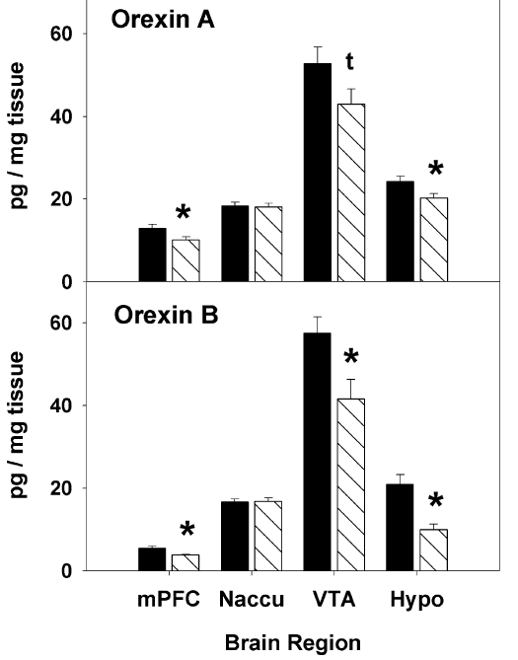
Hypothalamic Peptide Theory
W Muschamp, J., et al. (2014). Hypocretin (orexin) facilitates reward by attenuating the antireward effects of its cotransmitter dynorphin in ventral tegmental area.
Nocjar, C., et al. (2012). "The social defeat animal model of depression shows diminished levels of orexin in mesocortical regions of the dopamine system, and of dynorphin and orexin in the hypothalamus." Neuroscience 218: 138-153.

Slide 47
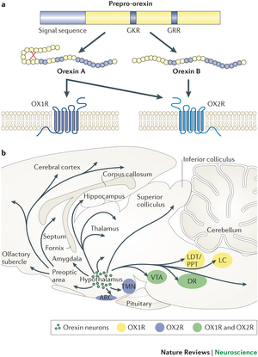
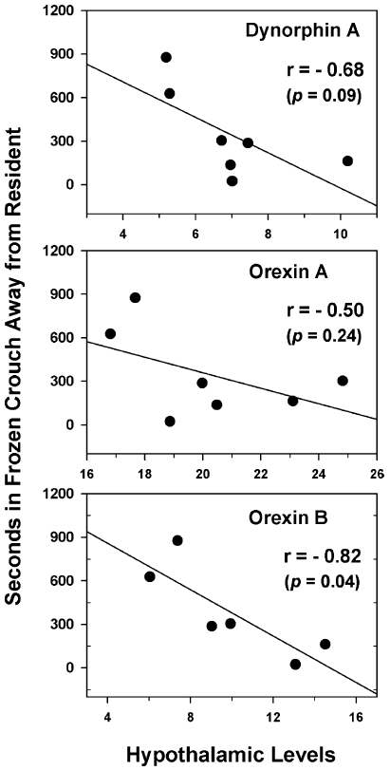
Hypothalamic Peptide Theory
Nocjar, C., et al. (2012). "The social defeat animal model of depression shows diminished levels of orexin in mesocortical regions of the dopamine system, and of dynorphin and orexin in the hypothalamus." Neuroscience 218: 138-153.

Slide 48
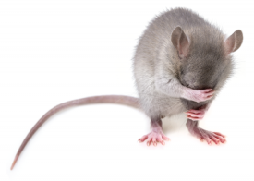
Hypothalamic Peptide Theory
To Relevant Brain Regions
Orexins
Dynorphin
Orexins & Dynorphin
Lateral Hypothalamus
W Muschamp, J., et al. (2014). Hypocretin (orexin) facilitates reward by attenuating the antireward effects of its cotransmitter dynorphin in ventral tegmental area.

Slide 49
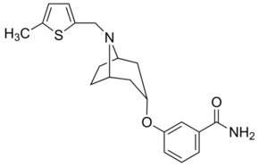

Hypothalamic Peptide Theory
Priming
To Relevant Brain Regions
Orexins
Dynorphin
Orexins & Dynorphin
Lateral Hypothalamus
W Muschamp, J., et al. (2014). Hypocretin (orexin) facilitates reward by attenuating the antireward effects of its cotransmitter dynorphin in ventral tegmental area.

Slide 50
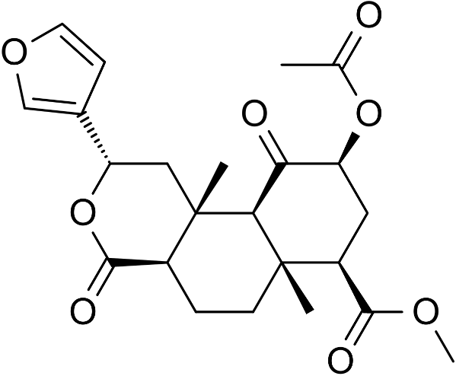

Hypothalamic Peptide Theory
To Relevant Brain Regions
Orexins
Dynorphin
Orexins & Dynorphin
Lateral Hypothalamus
W Muschamp, J., et al. (2014). Hypocretin (orexin) facilitates reward by attenuating the antireward effects of its cotransmitter dynorphin in ventral tegmental area.

Slide 51


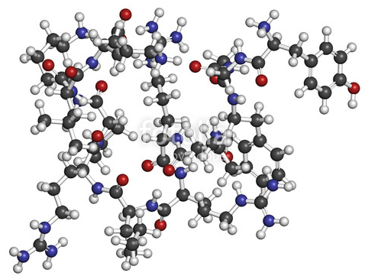
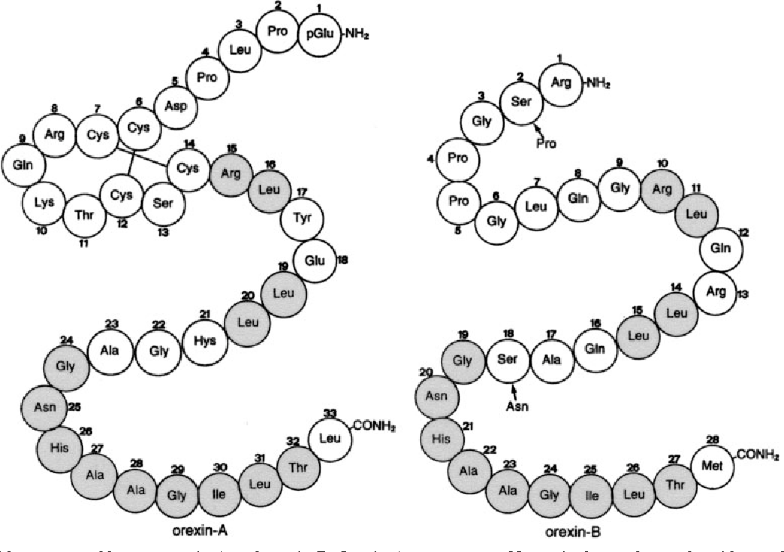
Hypothalamic Peptide Theory
Perhaps...
The balance between hypothalamic Orexins and Dynorphins can impact mood...
and Timing may play a critical part

Slide 52
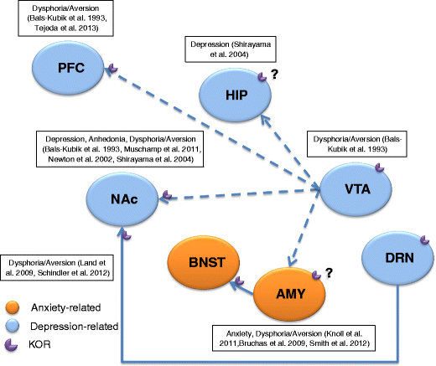
Receptor Theory
Van’t Veer, A., & Carlezon, W. A. (2013). Role of kappa-opioid receptors in stress and anxiety-related behavior. Psychopharmacology, 229(3), 435-452.

Slide 53
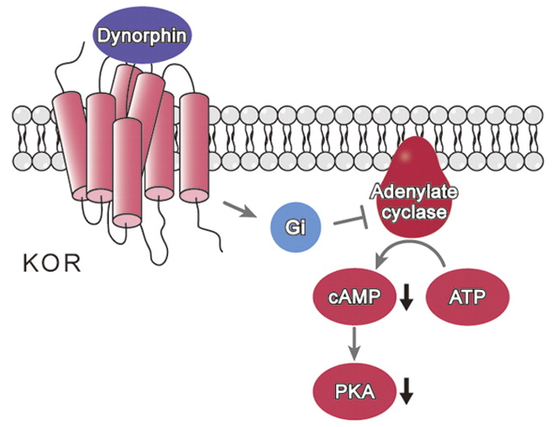
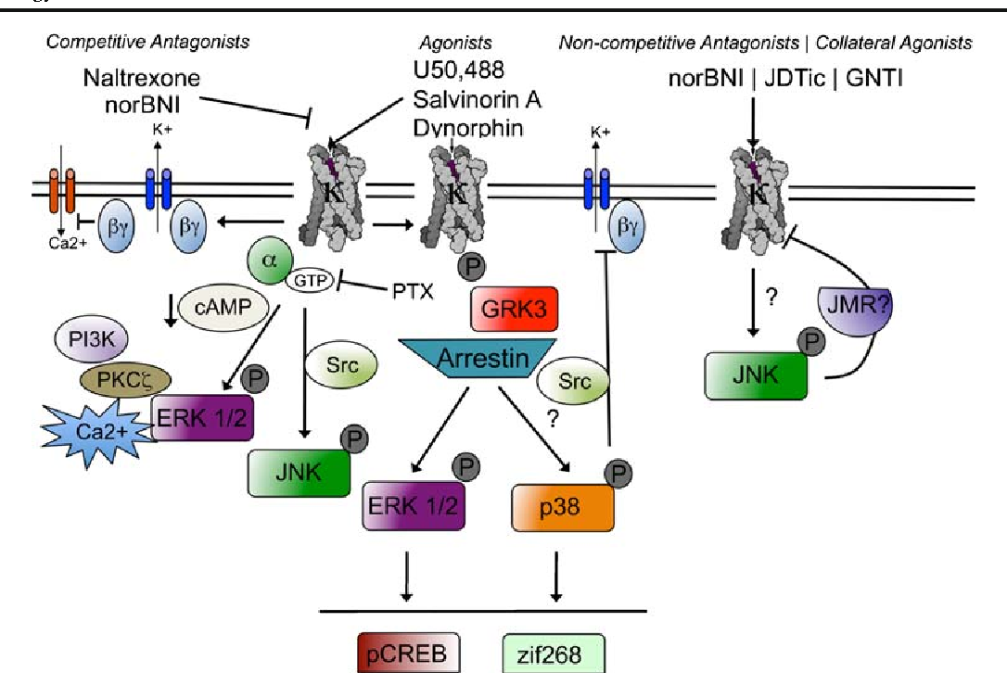
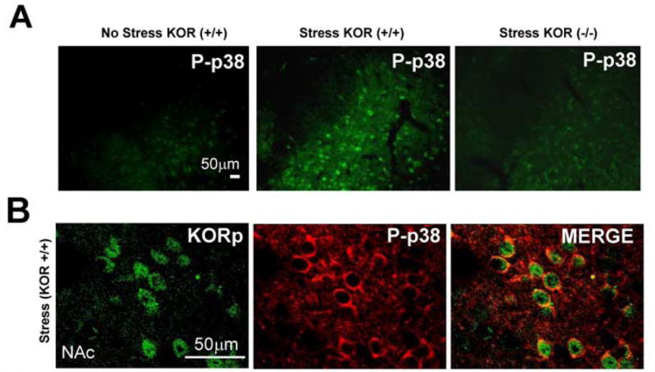
Receptor Theory
Yamamizu, K., et al. (2011). "The κ opioid system regulates endothelial cell differentiation and pathfinding in vascular development." Blood 118(3): 775-785.
Bruchas, M. R., et al. (2007). "Stress-induced p38 mitogen-activated protein kinase activation mediates kappa-opioid-dependent dysphoria." J Neurosci 27(43): 11614-11623.
Bruchas, M.R., & Chavkin, C. (2010). Kinase cascades and ligand-directed signaling at the kappa opioid receptor. Psychopharmacology, 210, 137-147.

Slide 54
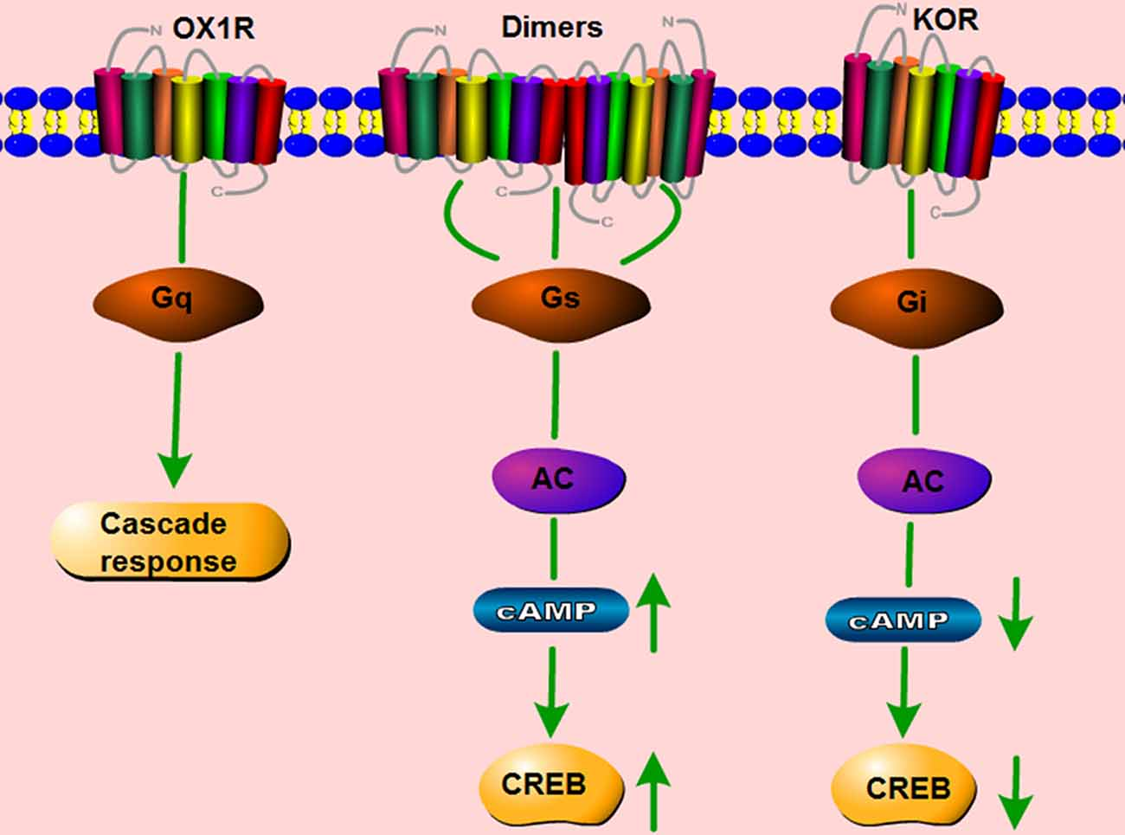
Receptor Theory
During depression:
↓ KOR/Orx₁ Dimers
Wang, C., et al. (2018). "The Orexin/Receptor System: Molecular Mechanism and Therapeutic Potential for Neurological Diseases." Frontiers in molecular neuroscience 11(220).

Slide 55

Claustrum Theory
Claustrum is a synchrony detector:
that neurons respond more robustly to synchronized bursts then to random spikes, and
that neurons tend to reproduce in their efferent outputs the pattern of synchronization contained in their afferent inputs
Smythies, J., Edelstein, L., & Ramachandran, V. (2012). Hypotheses relating to the function of the claustrum. Frontiers in integrative neuroscience, 6, 53. doi:10.3389/fnint.2012.00053

Slide 56

Overall...its Complicated...
Manipulation of KOR for antidepressive action:
May depend on neuropeptide balance
Timing is definitely important
Specific receptor signaling cascades likely play a role
The claustrum cannot be ignored

